Slide 1

Chapter 12
Multiple Access
Copyright © The McGraw-Hill Companies, Inc. Permission required for reproduction or display.

Slide 2
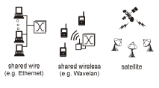
Multiple Access
Broadcast link used in LAN consists of multiple sending and receiving nodes connected to or use a single shared link
Broadcast links Examples

Slide 3

Figure 12.1 Data link layer divided into two functionality-oriented sublayers
Responsible for error and flow control
Link Layer Control (LLC)
Control
MAC
Responsible framing and MAC address and Multiple Access Control

Slide 4
Multiple Access
Problem: When two or more nodes transmit at the same time, their frames will collide and the link bandwidth is wasted during collision
  How to coordinate the access of multiple sending/receiving nodes to the shared link???
Solution: We need a protocol to coordinate the transmission of the active nodes
These protocols are called Medium or Multiple Access Control (MAC) Protocols belong to a sublayer of the data link layer called MAC (Medium Access Control)
What is expected from Multiple Access Protocols:
  Main task is to minimize collisions in order to utilize the bandwidth by:
    Determining when a station can use the link (medium)
    what a station should do when the link is busy
    what the station should do when it is involved in collision

Slide 5

Figure 12.2 Taxonomy of multiple-access protocols discussed in this chapter
For wireless not included with us

Slide 6
Random Access
Random Access (or contention) Protocols:
  No station is superior to another station and none is assigned the control over another.
  A station with a frame to be transmitted can use the link directly based on a procedure defined by the protocol to make a decision on whether or not to send.
ALOHA Protocols
Was designed for wireless LAN and can be used for any shared medium
Pure ALOHA Protocol Description
  All frames from any station are of fixed length (L bits)
  Stations transmit at equal transmission time (all stations produce frames with equal frame lengths).
  A station that has data can transmit at any time
  After transmitting a frame, the sender waits for an acknowledgment for an amount of time (time out) equal to the maximum round-trip propagation delay = 2* t_{prop}(see next slide)
  If no ACK was received, sender assumes that the frame or ACK has been destroyed and resends that frame after it waits for a random amount of time
  If station fails to receive an ACK after repeated transmissions, it gives up
  Channel utilization or efficiency or Throughput is the percentage of the transmitted frames that arrive successfully (without collisions) or the percentage of the channel bandwidth that will be used for transmitting frames without collisions
  ALOHA Maximum channel utilization is 18% (i.e, if the system produces F frames/s, then 0.18 * F frames will arrive successfully on average without the need of retransmission).

Slide 7

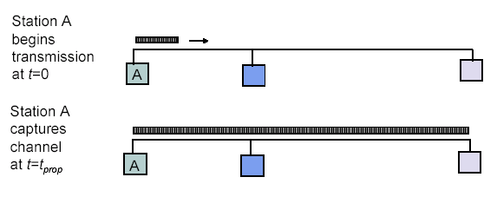
Maximum Propagation Delay
Maximum propagation delay(t_{prop}): time it takes for a bit of a frame to travel between the two most widely separated stations.
The farthest station
Station B receives the first bit of the frame at time t= t_{prop}

Slide 8
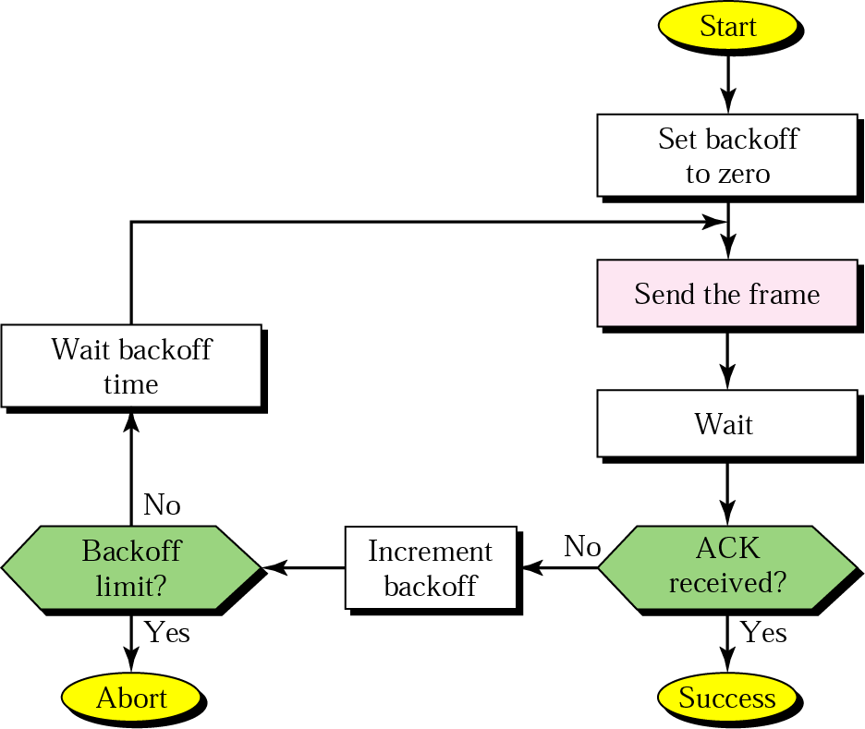
Figure 13.4 Procedure for ALOHA protocol

Slide 9

Critical time for pure ALOHA protocol
T_{fr}= Frame Transmission time
If the frame transmission time is T sec, then the vulnerable time is = 2 T sec.
This means no station should send during the T-sec before this station starts transmission and no station should start sending during the T-sec period that the current station is sending.

Slide 10
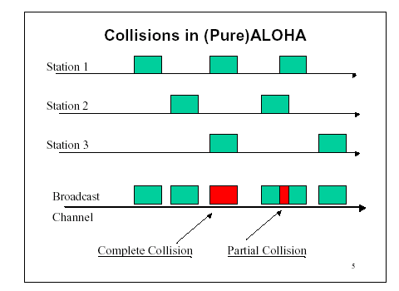
Pure ALOHA
In pure ALOHA, frames are transmitted at completely arbitrary times.

Slide 11

Note
The throughput ( S) for pure ALOHA is
S = G × e ^{−2G} .
The maximum throughput
S_{max} = 0.184 when G= (1/2).
G = Average number of frames generated by the system (all stations) during one frame transmission time

Slide 12
Random Access – Slotted ALOHA
Time is divided into slots equal to a frame transmission time (T_{fr})
A station can transmit at the beginning of a slot only
If a station misses the beginning of a slot, it has to wait until the beginning of the next time slot.
A central clock or station informs all stations about the start of a each slot
Maximum channel utilization is 37%

Slide 13

In danger time for slotted ALOHA protocol

Slide 14
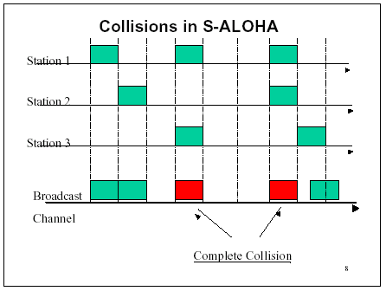
Random Access – Slotted ALOHA

Slide 15
Note
The throughput for slotted ALOHA is
S = G × e^{−G} .
The maximum throughput
S_{max} = 0.368 when G = 1.

Slide 16
Efficiency of Aloha
0.4
0.3
S = throughput =(success rate)
Slotted Aloha
0.2
0.1
Pure Aloha
0.5
1.0
1.5
2.0
G = offered load rate= new frames+ retransmitted
= Total frames presented to the link per
the transmission time of a single frame

Slide 17
Advantage of ALOHA protocols
  A node that has frames to be transmitted can transmit continuously at the full rate of channel (R bps) if it is the only node with frames
  Simple to be implemented
  No master station is needed to control the medium
Disadvantage
  If (M) nodes want to transmit, many collisions can occur and the rate allocated for each node will not be on average R/M bps
  This causes low channel utilization

Slide 18
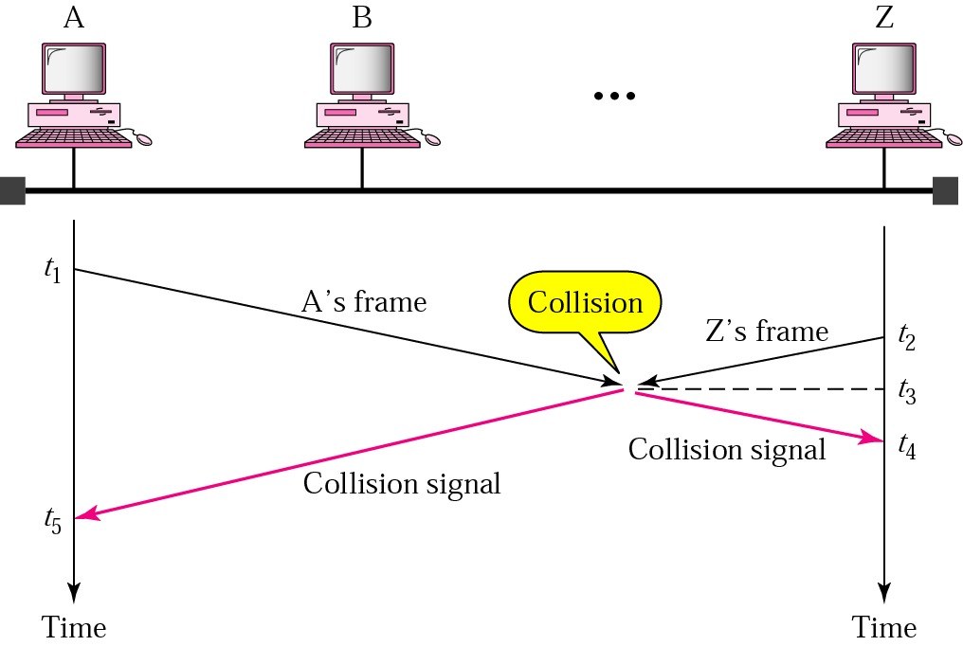
Random Access – Carrier Sense Multiple Access (CSMA)
To improve performance, avoid transmissions that are certain to cause collisions
Based on the fact that in LAN propagation time is very small
➔ If a frame was sent by a station, All stations knows immediately so they can wait before start sending
  ➔ A station with frames to be sent, should sense the medium for the presence of another transmission (carrier) before it starts its own transmission
This can reduce the possibility of collision but it cannot eliminate it.
  Collision can only happen when more than one station begin transmitting within a short time (the propagation time period)

Slide 19

Random Access – Carrier Sense Multiple Access (CSMA)
Vulnerable time for CSMA is the maximum propagation time
The longer the propagation delay, the worse the performance of the protocol because of the above case.

Slide 20
Types of CSMA Protocols
  Different CSMA protocols that determine:
  What a station should do when the medium is idle?
  What a station should do when the medium is busy?
    Non-Persistent CSMA
    1-Persistent CSMA
    p-Persistent CSMA

Slide 21
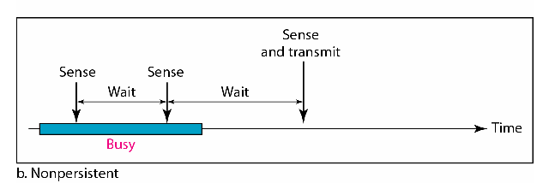
Nonpersistent CSMA
A station with frames to be sent, should sense the medium
  If medium is idle, transmit; otherwise, go to 2
  If medium is busy, (backoff) wait a random amount of time and repeat 1
Non-persistent Stations are deferential (respect others)
Performance:
  Random delays reduces probability of collisions because two stations with data to be transmitted will wait for different amount of times.
  Bandwidth is wasted if waiting time (backoff) is large because medium will remain idle following end of transmission even if one or more stations have frames to send
Random Waiting times
Wasted time

Slide 22
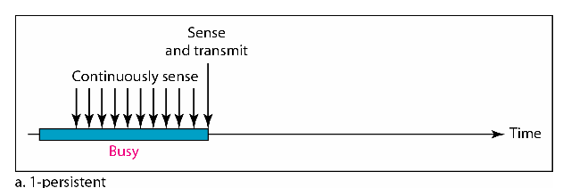
1-persistent CSMA
To avoid idle channel time, 1-persistent protocol used
Station wishing to transmit listens to the medium:
  If medium idle, transmit immediately;
  If medium busy, continuously listen until medium becomes idle; then transmit immediately with probability 1
Performance
  1-persistent stations are selfish
  If two or more stations becomes ready at the same time, collision guaranteed

Slide 23
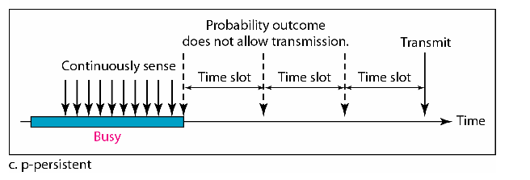
P-persistent CSMA
Time is divided to slots where each Time unit (slot) typically equals maximum propagation delay
Station wishing to transmit listens to the medium:
If medium idle,
  transmit with probability (p), OR
  wait one time unit (slot) with probability (1 – p), then repeat 1.
If medium busy, continuously listen until idle and repeat step 1
Performance
  Reduces the possibility of collisions like nonpersistent
  Reduces channel idle time like 1-persistent

Slide 24

Flow diagram for three persistence methods

Slide 25
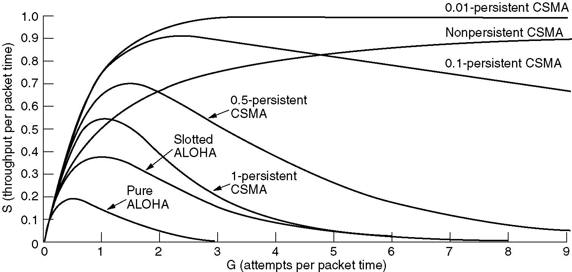
Persistent and Nonpersistent CSMA
Comparison of the channel utilization versus load for various random access protocols.

Slide 26
CSMA/CD (Collision Detection)
CSMA (all previous methods) has an inefficiency:
  If a collision has occurred, the channel is unstable until colliding packets have been fully transmitted
CSMA/CD (Carrier Sense Multiple Access with Collision
Detection) overcomes this as follows:
  While transmitting, the sender is listening to medium for collisions.
  Sender stops transmission if collision has occurred reducing channel wastage .
CSMA/CD is Widely used for bus topology LANs (IEEE 802.3, Ethernet).

Slide 27
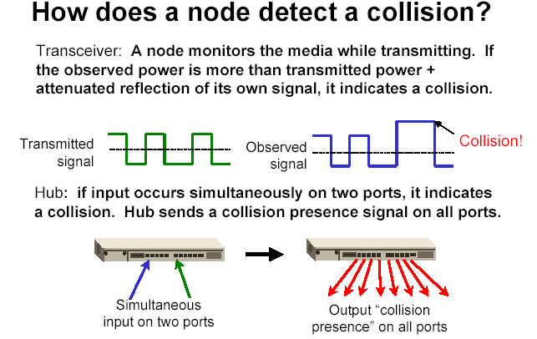
of its own
signal, it means collision occurred

Slide 28
CSMA/CD Protocol
Use one of the CSMA persistence algorithm
(non-persistent, 1-persistent, p-persistent) for
transmission
If a collision is detected by a station during its transmission then it should do the following:
  Abort transmission and
  Transmit a jam signal (48 bit) to notify other stations of collision so that they will discard the transmitted frame also to make sure that the collision signal will stay until detected by the furthest station
  After sending the jam signal, backoff (wait) for a random amount of time, then
  Transmit the frame again

Slide 29
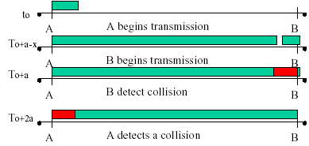
CSMA/CD
Question: How long does it take to detect a collision?
Answer: In the worst case, twice the maximum propagation delay of the medium
Note: a = maximum propagation delay

Slide 30
CSMA/CD
Restrictions of CSMA / CD:
  Packet transmission time should be at least as long as the time needed to detect a collision (2 * maximum propagation delay + jam sequence transmission time)
  Otherwise, CSMA/CD does not have an advantage over CSMA

Slide 31
Exponential Backoff Algorithm
Ethernet uses the exponential backoff algorithms to determine the best duration of the random waiting period after the collision happens
Algorithm:
  Set “slot time” equal to 2*maximum propagation delay + Jam sequence transmission time (= 51.2 usec for Ethernet 10-Mbps LAN)
  After K^{th} collision, select a random number (R) between 0 and
  2^{k} –1 and wait for a period equal to (R*slot time) then retransmit when the medium is idle, for example:
    After first collision (K=1), select a number (R) between 0 and 2¹ –1 {0 ,1} and wait for a period equal to R*slot times (Wait for a period 0 usec or 1x51.2 usec) then retransmit when the medium is idle
  Do not increase random number range, if K=10
    ➔ Maximum interval {0 – 1023}
  Give up after 16 unsuccessful attempts and report failure to higher layers

Slide 32

Figure 12.14 Flow diagram for the CSMA/CD
N=0
Wait R*slot time
Choose R between 0 & 2^{k} - 1
K=10
K=N
No
Yes
No
N < 10
N==16
N=N+1
Yes
Abort

Slide 33
Exponential Backoff Algorithm
Reduces the chance of two waiting stations picking the same random waiting time
When network traffic is light, it results in minimum waiting time before transmission
As congestion increases ( traffic is high), collisions increase, stations backoff by larger amounts to reduce the probability of collision.
Exponential Back off algorithm gives last-in, first-out effect
  Stations with no or few collisions will have the chance to transmit before stations that have waited longer because of their previous unsuccessful transmission attempts.

Slide 34
Performance of Random Access Protocols
Simple and easy to implement
Decentralized (no central device that can fail and bring down the entire system)
In low-traffic, packet transfer has low-delay
However, limited throughput and in heavier traffic, packet delay has no limit.
In some cases, a station may never have a chance to transfer its packet. (unfair protocol)
A node that has frames to be transmitted can transmit continuously at the full rate of channel (R) if it is the only node with frames
If (M) nodes want to transmit, many collisions can occur and the rate for each node will not be on average R/M

Slide 35
13.2 Controlled Access or Scheduling
Provides in order access to shared medium so that every station has chance to transfer (fair protocol)
Eliminates collision completely
Three methods for controlled access:
  Reservation
  Polling
  Token Passing

Slide 36

1-Reservation access method
Stations take turns transmitting a single frame at a full rate ( R ) bps
Transmissions are organized into variable length cycles
Each cycle begins with a reservation interval that consists of (N) minislots. One minislot for each of the N stations
When a station needs to send a data frame, it makes a reservation in its own minislot.
By listening to the reservation interval, every station knows which stations will transfer frames, and in which order.
The stations that made reservations can send their data frames after the reservation frame.

Slide 37
2- Polling
Stations take turns accessing the medium
Two models: Centralized and distributed polling
Centralized polling
  One device is assigned as primary station and the others as secondary stations
  All data exchanges are done through the primary
  When the primary has a frame to send it sends a select frame that includes the address of the intended secondary
  When the primary is ready to receive data it send a Poll frame for each device to ask if it has data to send or not. If yes, data will be transmitted otherwise NAK is sent.
  Polling can be done in order (Round-Robin) or based on predetermined order
Distributed polling
  No primary and secondary
  Stations have a known polling order list which is made based on some protocol
  station with the highest priority will have the access right first, then it passes the access right to the next station (it will send a pulling message to the next station in the pulling list), which will passes the access right to the following next station, …

Slide 38

Figure 12.19 Select and poll functions in polling access method
Primary is sending to Secondary
Secondary is sending to Primary

Slide 39
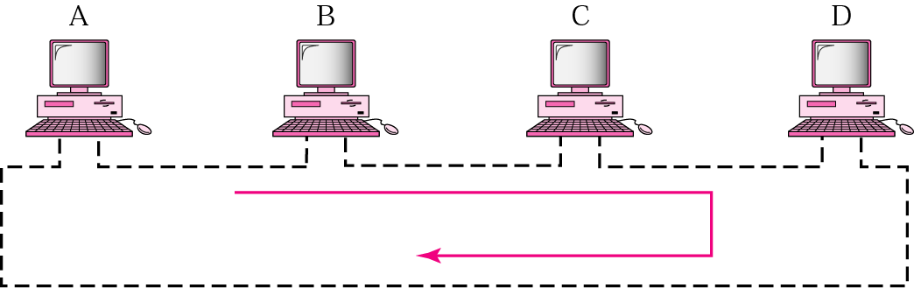
3- Token-Passing network
Implements Distributed Polling System
bits are copied to the output bits with a one bit delay
Bits are inserted by the station
listen mode
transmit mode
input
from
ring
1 bit delay
output
to
ring
delay
to station
from station
to station
from station
Station Interface is in two states:
  Listen state: Listen to the arriving bits and check the destination address to see if it is its own address. If yes the frame is copied to the station otherwise it is passed through the output port to the next station.
  Transmit state: station captures a special frame called free token and transmits its frames. Sending station is responsible for reinserting the free token into the ring medium and for removing the transmitted frame from the medium.

Slide 40
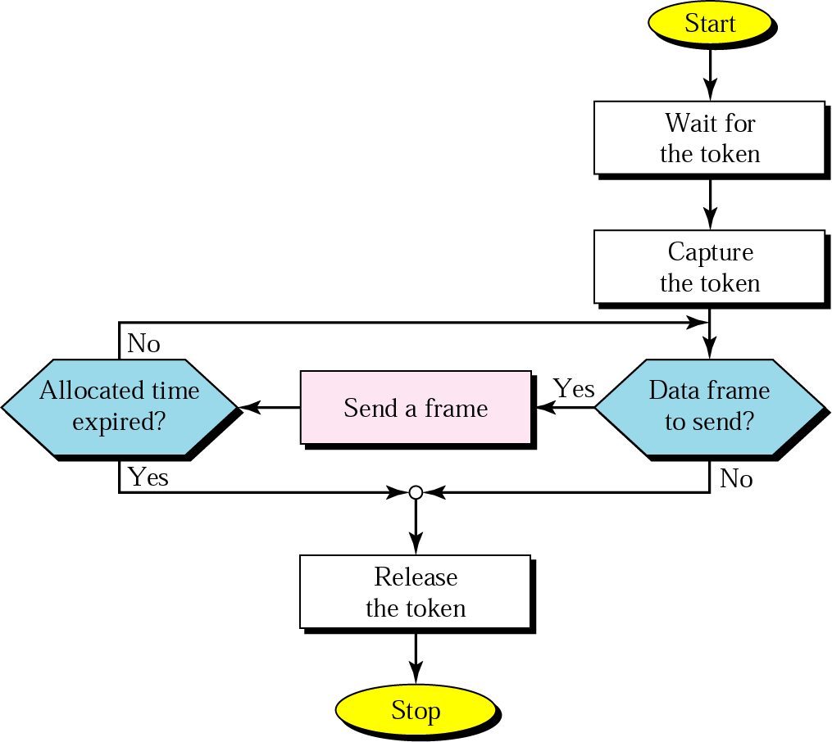
Figure 13.13 Token-passing procedure

Slide 41
12-3 CHANNELIZATION
Channelization is a multiple-access method in which the available bandwidth of a link is shared in time, frequency, or through code, between different stations. In this section, we discuss three channelization protocols.
Topics discussed in this section:
Frequency-Division Multiple Access (FDMA)
Time-Division Multiple Access (TDMA)
Code-Division Multiple Access (CDMA)

Slide 42

Figure 12.21 Frequency-division multiple access (FDMA)

Slide 43
12-3 CHANNELIZATION - FDMA
FDMA: Frequency Division Multiple Access:
  Transmission medium is divided into M separate frequency bands
  Each station transmits continuously on the assigned band at an average rate of R/M
  A node is limited to an average rate equal R/M (where M is number of nodes) even when it is the only node with frame to be sent

Slide 44

Figure 12.22 Time-division multiple access (TDMA)

Slide 45
12-3 CHANNELIZATION - TDMA
TDMA: Time Division Multiple Access
  The entire bandwidth capacity is a single channel with its capacity shared in time between M stations
  A node must always wait for its turn until its slot time arrives even when it is the only node with frames to send
  A node is limited to an average rate equal R/M (where M is number of nodes) even when it is the only node with frame to be sent

Slide 46
12-3 CHANNELIZATION - CDMA
CDMA: Code Division Multiple Access
  In CDMA, one channel carries all transmissions simultaneously
  Each station codes its data signal by a specific codes before transmission
  The stations receivers use these codes to recover the data for the desired station

Slide 47

Figure 12.23 Simple idea of communication with code
12.<number>

Slide 48
The basic characteristics of LANs
The operation of IEEE 802 LANs
802.3 - CSMA/CD-based (Ethernet)

Slide 49
Key features of LANs are:
Limited geographical area – which is usually less than 10 Km and more than 1 m.
• High Speed – 10 Mbps to 1000 Mbps (1 Gbps) and more
• High Reliability – 1 bit error in 1011 bits.
• Transmission Media – Guided and unguided media, mainly guided media is used; except in a situation where infrared is used to make a wireless LAN in a room.
• Topology – It refers to the ways in which the nodes are connected. There are various topologies used.
• Medium-Access Control Techniques –Some access control mechanism is needed to decide which station will use the shared medium at a particular point in time.

Slide 50
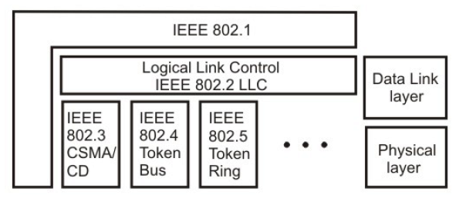
Bunch of LAN standards collectively known as IEEE 802 LANs satisfies diverse requirements, the standard includes CSMA/CD, Token bus, Token
Ring medium access control techniques along with different topologies. All these standards differ at the physical layer and MAC sublayer, but are compatible at the data link layer.
IEEE 802 Legacy LANs
The 802.1 sublayer gives an introduction to set of standards and gives the details of the interface primitives.
It provides relationship between the OSI model and the 802 standards.
The 802.2 sublayer describes the LLC (logical link layer), which is the upper part of the data link layer. LLC facilitate error control and flow control for reliable communication. It appends a header containing sequence number and acknowledgement number. And offers the following three types of services:
Unreliable datagram service
Acknowledged datagram service
Reliable connection oriental service
The standards 802.3, 802.4 and 802.5 describe three LAN standards based on the CSMA/CD, token bus and token ring, respectively. Each standard covers the physical layer and MAC sublayer protocols.

Slide 51
IEEE 802.3 and Ethernet
The original Ethernet was developed as an experimental coaxial cable network in the 1970s by Xerox Corporation to operate with a data rate of 3 Mbps using a carrier sense multiple access collision detection (CSMA/CD) protocol for LANs with sporadic traffic requirements.
The term Ethernet refers to the family of local-area network (LAN) products covered by the IEEE 802.3 standard that defines what is commonly known as the CSMA/CD protocol.
Three data rates are currently defined for operation over optical fiber and twisted-pair cables:
10 Mbps—10Base-T Ethernet
100 Mbps—Fast Ethernet
1000 Mbps—Gigabit Ethernet

Slide 52
Why Ethernet ?
Ethernet has survived as the major LAN technology
It is currently used for approximately 85 percent of the world's LAN-connected PCs and workstations
Its protocol has the following characteristics:
  It is easy to understand, implement, manage, and maintain
  It allows low-cost network implementations
  It provides extensive topological flexibility for network installation
  It guarantees successful interconnection and operation of standards-compliant products, regardless of manufacturer

Slide 53
Ethernet Architecture
Ethernet architecture can be divided into two layers:
􀂾 Physical layer: this layer takes care of following functions.
-Encoding and decoding
-Collision detection
-Carrier sensing
-Transmission and receipt
􀂾 Data link layer: Following are the major functions of this layer.
-Station interface
-Data Encapsulation /Decapsulation
-Link management
-Collision Management

